Slide 1
HOW COVID HAS AFFECTED PEOPLE’S FOOD HABITS
İhsan Tarık Akkoyunlu
17030411057

Slide 2
PEOPLE'S NUTRITIONAL HABITS IN GENERAL HAVE CHANGED DURING THE COVID PERIOD

Slide 3
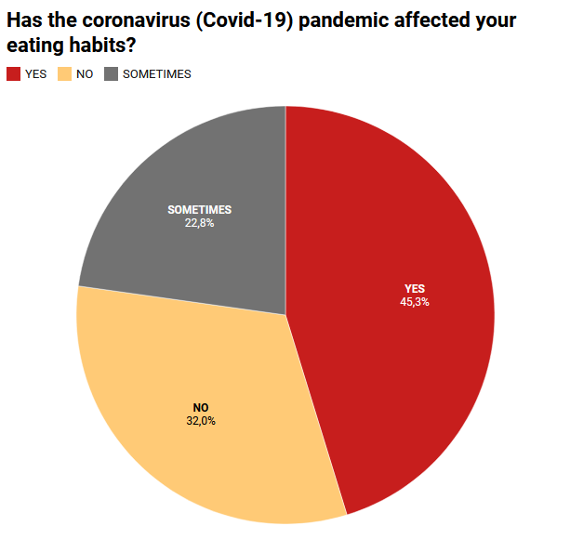
According to the survey results, the number of people whose food habits changed during the pandemic period is higher.
After that “NO” answer is second most rated answer.
Rest of the answer is “SOMETIMES”.
So, we can say that the pandemic has affected many people’s food habits.

Slide 4
ALSO, PEOPLE'S BUDGETS HAVE BEEN AFFECTED DUE TO FOOD EXPENDITURES DURING THE COVID PERIOD.

Slide 5
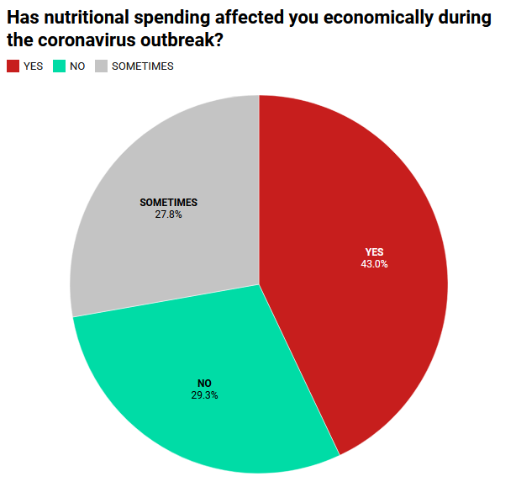
The survey results shows us most of the people’s budget are affected by nutritional spending.
“NO” answer is second most rated answer. And rest of the answer is “SOMETIMES” affected.

Slide 6
THE TYPES OF FOOD PEOPLE CONSUME IN THE COVID PERIOD HAVE ALSO CHANGED.

Slide 7
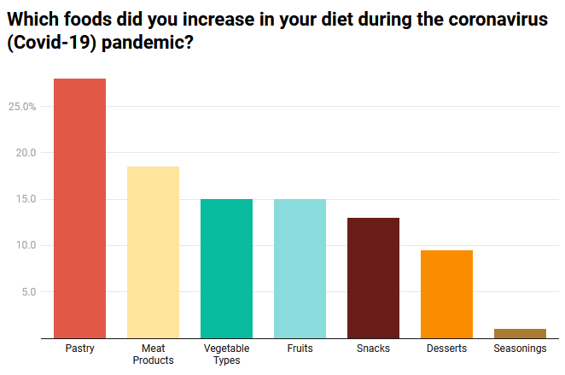
According to survey;
pastries was the most consumed food group by 25% increased
By 17.5% increased meat group was second most increased food type.
Consuming vegetables and fruits increased same rates.
Snacks consuming increased by 12.5%
Desserts are just under 10%
And least increased food types is seasonings.

Slide 8
THE NUMBER OF MEALS PEOPLE CONSUME DURING THE DAY HAS CHANGED.

Slide 9
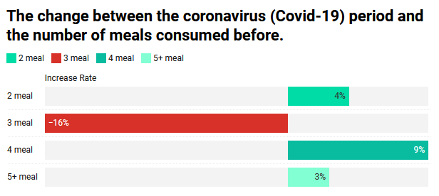
According to the results;
Number of people eating 2 meals increased 4 point.
Number of people eating 3 meal in a day is decreased 16 point!
4 meal increased by 9 point.
5 or more meals increased by 3 point.

Slide 10
CHANGES HAVE OCCURRED IN PEOPLE'S BODY WEIGHTS.

Slide 11
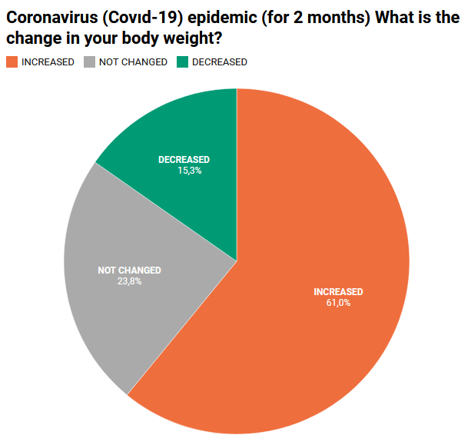
According to survey results;
The 61% of people say I gained weight.
15.3% people says I loss weight.
And 23.8% says my weight has not changed.
So many people gained weight in this period.

